Slide 1
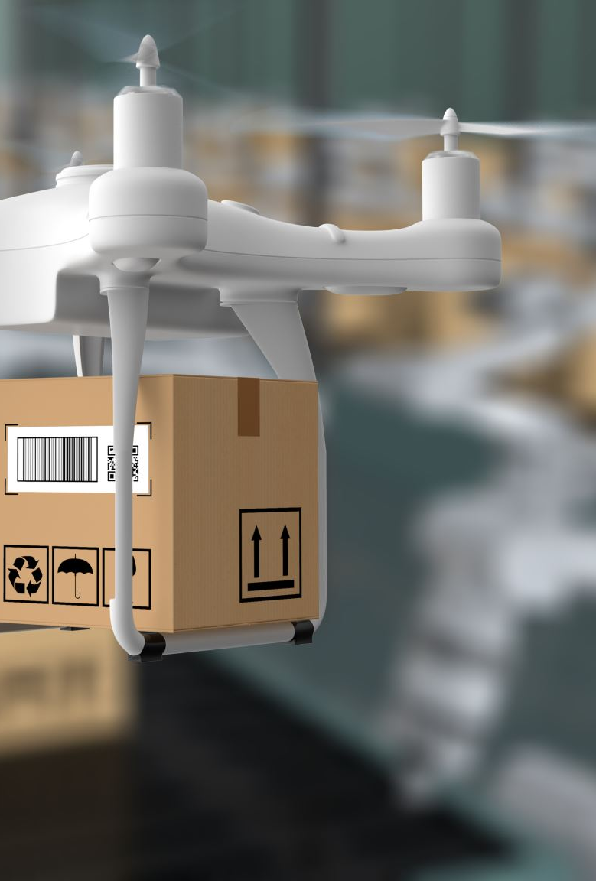
Ecommerce on Time Delivery Prediction SUBJECT: DATA 606(CAPSTONE PROJECT)
PROFESSOR: CHAOJIE WANG
PRECENTOR: Naga mounica potluri

Slide 2

1. Background
How well can a global e-commerce company's operational structure use predictive modelling to determine if a product will be delivered on time?
What complex elements affect the timely delivery of goods, and how can this nuanced knowledge be applied to improve and optimise the delivery procedures?

Slide 3

2. Data Description:
Data Sources: Kaggle and is related to an international e-commerce company's shipping data
Data Shape: 10,999 rows and 12 columns
ID: ID number of customers
Warehouse_block: Warehouse block categorization
Mode_of_Shipment: Mode of shipment
Customer_care_calls: The number of calls made for inquiries about the shipment
Customer_rating: Customer rating
Cost_of_the_Product: Cost of the product in US Dollars
Prior_purchases: The number of prior purchases made by the customer
Product_importance: Importance categorization of the product
Gender: Gender of the customer
Discount_offered: Discount offered on the specific product
Weight_in_gms: Weight of the product in grams
Reached.on.Time_Y.N: Target variable, where 1 indicates that the product has NOT reached on time, and 0 indicates it has reached on time

Slide 4

3. Exploratory Data Analysis
Missing Values: The dataset contains no missing values; all columns include non-null items.
Duplicate Rows: The dataset contains no duplicate rows.
On the dataset, we performed an exploratory data analysis , omitting all other columns and concentrating on the target variable "Reached.on. Time_Y.N" and chosen characteristics
The following are the main conclusions and actions taken during the EDA

Slide 5
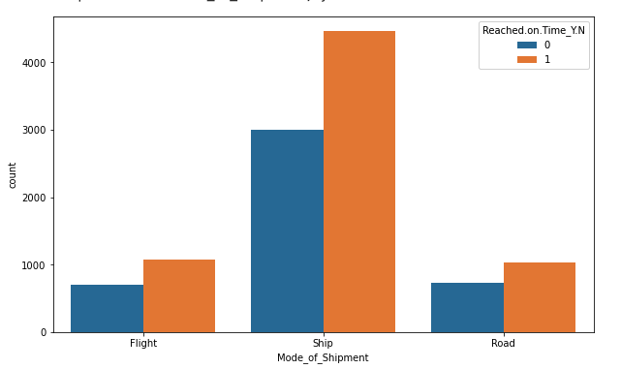
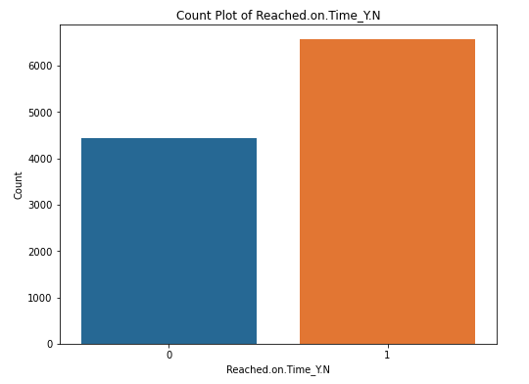
3.1 Data Visualizations
Plot 1: Count Plot for the Product to Reaching on Time or Not
Plot 2: Count Plot for Mode of Shipment

Slide 6
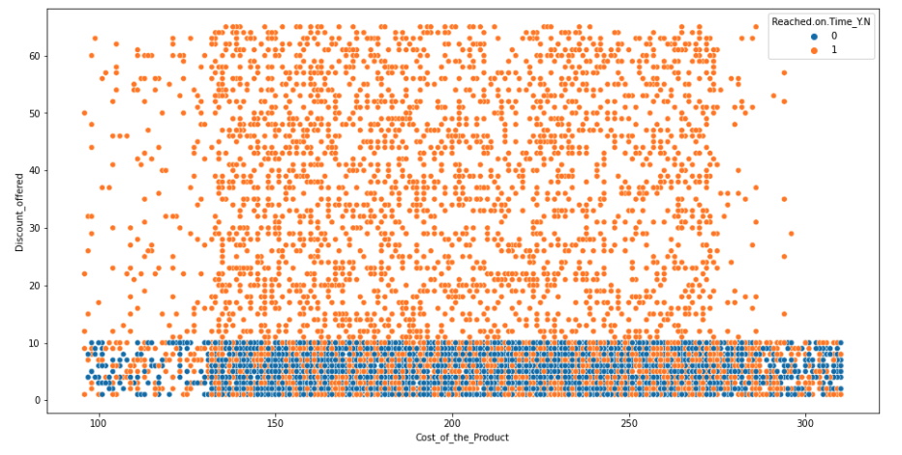
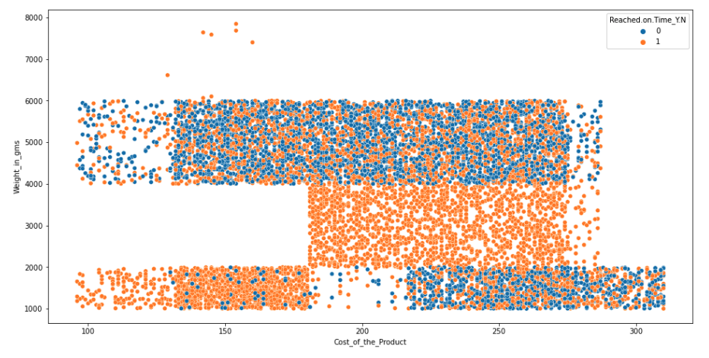
3.1 Data Visualizations
Plot 3: Cost of Product vs Discount Offered
Plot 4: Cost of product vs Weight

Slide 7
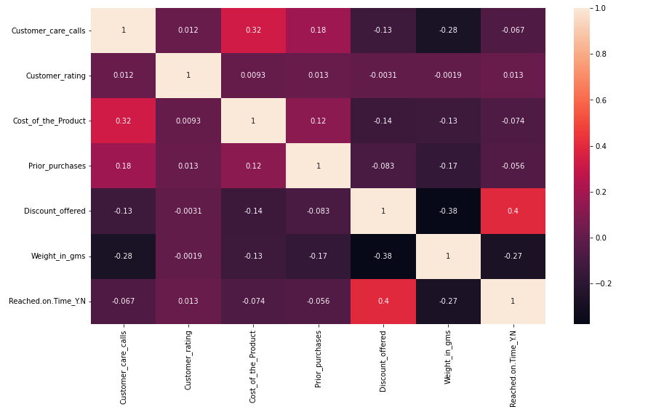
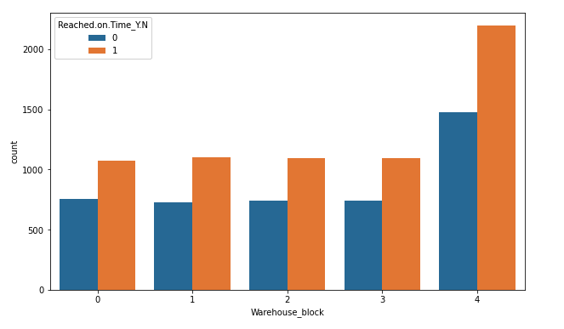
3.1 Data Visualizations
Plot 5: Count plot for Warehouse Block
Plot 6: Heatmap Showing the Correlation between the columns

Slide 8
4 Models used for Machine Learning
Logistic Regression
Random Forest Classifier
Gradient Boosting Classifier
XGBoost Classifier
Best Random Forest Classifier
Best Gradient Boosting Classifier
Measuring and Comparing Model Performance​:
​
Accuracy: This statistic assesses how accurately the model's predictions were made in general
Precision: How much of the model's favorable predictions were accurate is known as precision
Recall: Recall indicates the proportion of real positive cases that the model accurately predicted
F1-Score: The F1-score, which is important when there is an imbalance in the classes, is the harmonic mean of accuracy and recall
Confusion Matrix: A confusion matrix gives a thorough description of the right and wrong guesses

Slide 9
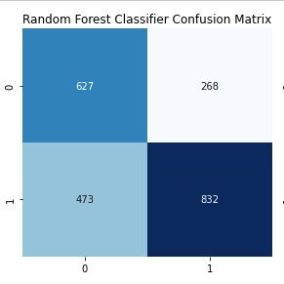
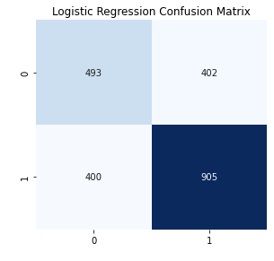
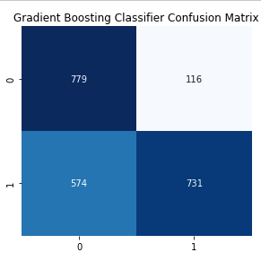
4.1 Measuring and Comparing Model Performance
Accuracy: 64.45%​
True Positives : 905
True Negatives : 493
False Positives : 402
False Negatives : 400
Accuracy: 65.95%​
True Positives : 832
True Negatives : 627
False Positives : 268
False Negatives : 473
Accuracy: 68.73%​
True Positives : 731
True Negatives : 779
False Positives : 116
False Negatives : 574

Slide 10
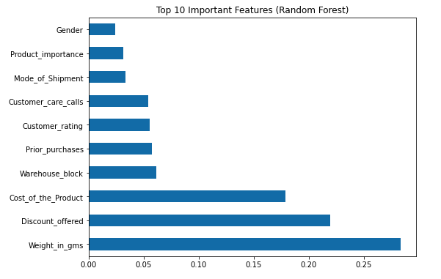
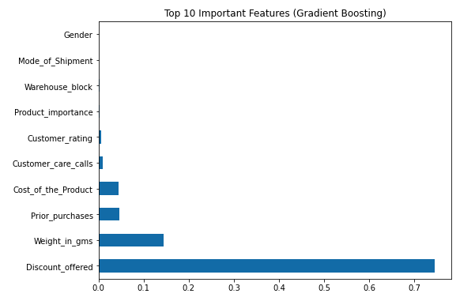
4.1 Measuring and Comparing Model Performance
In this section, plotted Top 10 Important Features for Each Model​
This Section gives us information of which and How Much a Feature in Important in Model Training

Slide 11
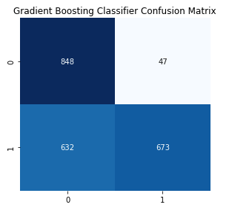
4.2 Hyper Parameter Tuning
After Hyper Parameter Tuning
Before Hyper Parameter Tuning
Accuracy: 69.3%​
True Positives : 673
True Negatives : 848
False Positives : 47
False Negatives : 632
Accuracy: 68.03%​
True Positives : 731
True Negatives : 779
False Positives : 116
False Negatives : 574

Slide 12
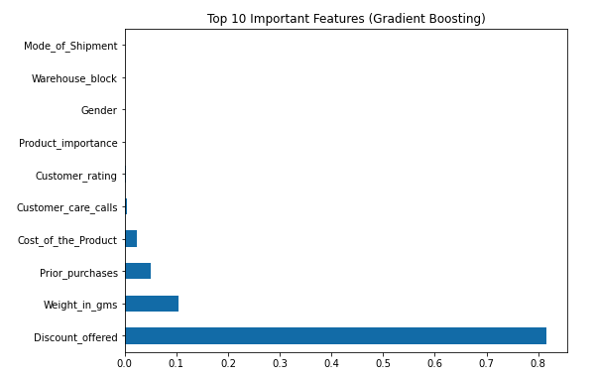
4.3 Measuring and Comparing Model Performance after Hyper Parameter Tuning
In this section, plotted Top 10 Important Features for Each Model​ after the Hyper Parameter Tuning

Slide 13
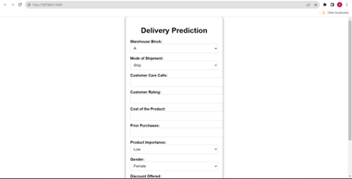
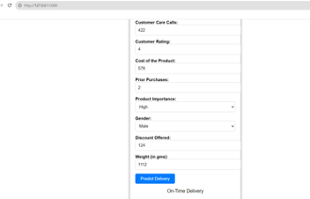
5 Web Application
For developing the web application I have used Flask.
Our trained machine learning models for forecasting delivery outcomes are easily accessible, through Flask's capability to seamlessly integrate them into a user-friendly web-based interface. This helps user an forecast their delivery to check if they might reach on time or not.

Slide 14

6. Conclusion
Through the use of predictive modelling, set out on a mission in this project to improve on-time delivery estimates in the e-commerce industry
Created, trained, and successfully used machine learning models that can forecast whether a product will arrive on time or not.
This research has enormous promise for the supply chain management and e-commerce sectors, providing insightful information and foresight tools to enhance user experience and operational effectiveness
Notes:
In this project, we set out to improve on-time delivery estimates in the e-commerce industry by using predictive modeling.
developed, honed, and effectively applied machine learning models that predict whether or not a product will arrive on schedule.
The supply chain management and e-commerce industries stand to benefit greatly from this research since it offers useful data and predictive tools that can improve user experience and operational efficacy.

Slide 15

6.2 Usage of Our Research
6.1 Lessons Learned
Data Preprocessing​
Model Selection​
Interpretability
Operational Efficiency
Customer Satisfaction
Inventory Management
Decision Support
Notes:
Operational Efficiency: Our models may be used by e-commerce businesses to streamline their delivery procedures, cut down on delays, and better manage resources
Customer Satisfaction: On time delivery boost client loyalty and happiness, which enhances the reputation of the company
Inventory Management: Predictive analytics may help with more effective inventory management, lowering expenses related to excess or inadequate stock
Decision Support: Our models may assist logistics managers in making data-driven choices by acting as decision support tools
Data Preprocessing: It is impossible to overestimate the significance of data preparation, which includes feature scaling and encoding categorical variables
Model Selection: Performance is greatly influenced by the careful selection of models and their hyperparameters
Interpretability: The interpretation and justification of model predictions to stakeholders is crucial for model adoption

Slide 16

6.4 Future Research Directions
Integration of External Data
Real-Time Predictions
Customer Behavior Analysis
Advanced Forecasting
Notes:
Integration of External Data: To improve forecast accuracy, future research might investigate the integration of external data sources including weather and traffic data
Real-Time Predictions: Constructing real-time prediction systems that take dynamic shifts in supply chain variables into consideration
Customer Behavior Analysis: To better understand how customer interactions affect delivery times, data on consumer behaviour will be analysed
Advanced Forecasting: Applying sophisticated time series forecasting techniques to make more precise delivery time predictions

Slide 17

Thank You !! Any Questions ??

